Slide 1


Analysis of Gauge Tool
By: Vidhyashree Nagabhushana(v_n63)

Slide 2
Overview
Introduction
Demo
Strengths
Weakness
Conclusion

Slide 3
INTRODUCTION
Simple, flexible, free and opensource
Rich syntax based on markdown
Writing step implementations in various languages
Modular architecture
Datadriven Testing and Parallel Execution

Slide 4





DEMO

Slide 5
STRENGTHS
Simple, flexible and user friendly
Usage of Tags
Using steps to write scenarios
Parallel Execution
Very descriptive Output
Data driven testing
Modular Architecture

Slide 6
WEAKNESS
False Results when a test is skipped
Limited support and training
Deployment limited to Mac, Windows, and Linux
Not Unicode Compliant
Time format for small tests

Slide 7
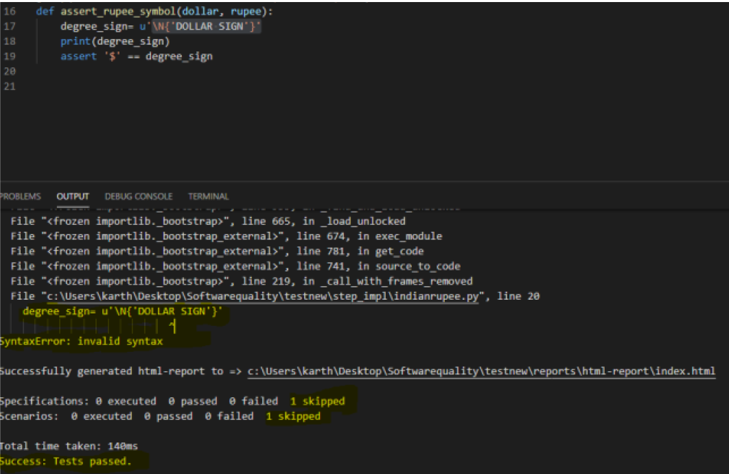
FALSE RESULTS WHEN A TEST IS SKIPPED

Slide 8
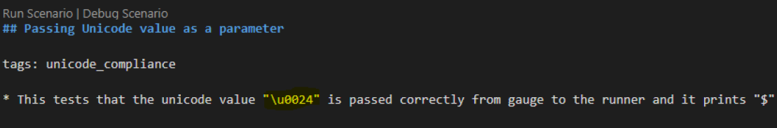
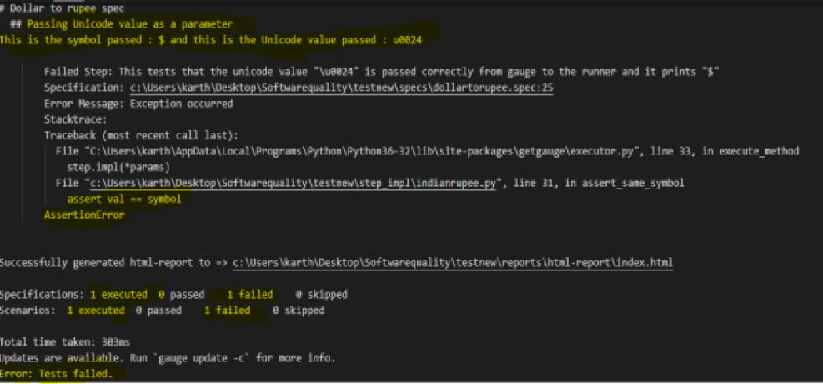
Not Unicode Compliant

Slide 9
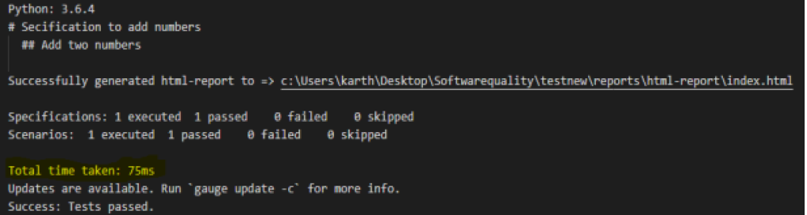
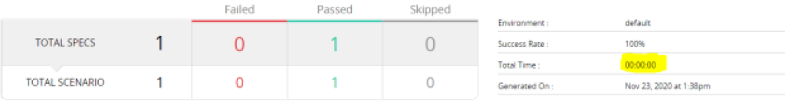
Time format for small tests

Slide 10
Conclusion
Gauge is a perfect tool that can be chosen for Acceptance testing as it is very simple, flexible and user friendly.
Having analyzed the tool for some time, I can conclude that testing gets easier with Gauge due to various features of the tool.

Slide 11
REFERENCES
[1] https://docs.gauge.org/?os=windows&language=python&ide=vscode
[2] https://www.softwaretestinghelp.com/what-is-acceptance-testing/
[3] https://www.capterra.com/p/147883/Gauge/
[4] https://blog.getgauge.io/why-we-built-gauge-6e31bb4848cd

Slide 12
Thank You

